Slide 1

Myanmar Internet Exchange
Update
Presenter :Thein Myint Khine
Version : 0.0
Update : 14 March 2024

Slide 2
MMIX Brief
Since Sept 2017.
Total 33 Members
  30 Peering Members
    24 Principal Members
    6 Affiliate Members
  3 Associate Members
Date Center
  Yangon IXP- True IDC, MICT Park
  Mandalay IXP – Ocean Wave IDC
  Naypyitaw POP – IT Spectrum DC-2
Major Contents – 4 x CDNs + Local Content
Aggregate Traffic Peak – 140 Gbps

Slide 3
MMIX Structure

Slide 4
Structure
Members - the governing body;
the Executive Council - acts on behalf of MMIX;
the Secretariat – daily operations and MMIX functions;
Sub-Committees – for specific functions;
Advisory Board – who shall advise MMIX;

Slide 5
1. Members
Principal Member
Institutional Member
Affiliate Member
Associate Member

Slide 6
Sr. | Member Name | Member Type | POP
1 | AGB Communication Co., Ltd. | Principal | YGN
2 | Southeastasianet Technologies Myanmar Co., Ltd | Principal | YGN
3 | Kinetic Myanmar Technology Co., Ltd. | Principal | YGN
4 | Yatanarpon Teleport Public Co., Ltd | Principal | YGN
5 | Fortune Telecom Co., Ltd. | Principal | YGN
6 | Horizon Telecom International Co., Ltd. | Principal | YGN
7 | KBZ Gateway Co., Ltd. | Associate | -
8 | Myanmar Unilink Communication Co., Ltd. | Principal | YGN
9 | Myanmar Information Highway Limited | Principal | YGN
10 | Telecom International Myanmar Co., Ltd. | Principal | YGN
11 | Golden Myanmar United Telecom Co., Ltd | Principal | YGN
12 | Marga Global Technology | Principal | YGN
13 | True IDC Myanmar Co., Ltd | Associate | -
14 | RIPE NCC | Affiliate | YGN,MDY
15 | WANGSU (Quantil Networks) | Affiliate | YGN,MDY
16 | Akamai Technologies | Affiliate | YGN,MDY
17 | Myanmar Technology Gateway Co., Ltd | Associate | -
Member Lists

Slide 7
Sr. | Member Name | Member Type | POP
18 | Myanmar Light Global Co., Ltd | Affiliate | YGN,MDY
19 | Myanmar Country Co., Ltd. | Principal | YGN,MDY
20 | Ocean Wave Communication Co., Ltd | Principal | YGN
21 | Campana Mythic Co., Ltd. | Principal | YGN
22 | Myanmar Broadband Telecom Co., Ltd. | Principal | YGN
23 | Packet Clearing House | Affiliate | YGN,MDY
24 | TelecoSpeed Communications Co., Ltd. | Principal | MDY
25 | IT Spectrum Myanmar Co., Ltd. | Principal | YGN(NPT)
26 | Kaopu Cloud | Affiliate | YGN,MDY
27 | AyarNet Co.,Ltd. | Principal | YGN
28 | Zoom Plus Co., Ltd | Principal | MDY
29 | Treasure Chindwin Land Co., Ltd | Principal | YGN
30 | Golden Dragon 2000 Co., Ltd | Principal | YGN
31 | Horizon Telecom International Co., Ltd. | Principal | MDY
32 | StreamNet Co., Ltd | Principal | MDY
33 | Yar Chang Co.,Ltd | Principal | MDY(TCL)
Member Lists

Slide 8
2. Executive Council
Sr. | Name | Orgnization | Address | Title
1 | Chan Mya Oo | Horizon Telecom International | Bago | Chairperson
2 | Arkar Zwe | Ocenwave | Sagaing | EC Member
3 | Min Maung Soe | Myanmar Internet Exchange | Yangon | Treasurer
4 | Naing Win | Southeastasianet Technologies Myanmar | Mandalay | EC Member
5 | Sai Nyan Lynn Swe | Myanmar Internet Exchange | Shan | Secretary
6 | Hla Myo | AGB Communication | Mon | EC Member
7 | Su Yee Nandar Aung | Marga Global Telecom Ltd | Taninthayi | EC Member
8 | Thein Myint Khine | Myanmar Internet Exchange | Yangon | CEO

Slide 9
Chief Executive Officer
Marketing
Engineering
Operations
Finance & Admin
Market Analysis
Technology Analysis
Feature Testing
Define Operations Flow
Financial Management
Tariffs (Pricing)
Network Design
Define Resources
Training
Cash Control
Marketing
Business Plan
Operate the Service
Accounting, Taxation, Auditing
Sales
Procurement
Customer Support
Recruitment
Implementation, Test Run, Training
Operations Support
Training & Event Arrangement
Billing
3. The Secretariat

Slide 10
5. Advisory board
Posts and Telecommunications Department, Ministry of Transport and Communications
Information Technology and Cyber Security Department, Ministry of Transport and Communications

Slide 11
Advisory Board
Advise
Advise
Advise
MMIX Members
Elect
Executive Council
Appoint
(CEO)
Secretariat
Plan Policies
Define Polies
Budget Approval
Get Approval
Approve
Operations and Developments
Form
Sub-Committees
Projects,
Functions

Slide 12
Board of Directors
CEO
Engineering & Operations
Project Management
Research
Partner/Vendor/Gov. Relationship
Network Operations Center
Preventive Maintenance
Incident Management
Finance
Financial Management
Cash Control
International Exchange
Accounting
Audition
Taxation
Marketing
Market info Collection (Local/Overseas)
Sales
Tariffs (Pricing)
Advertising

Slide 13
Current

Slide 14
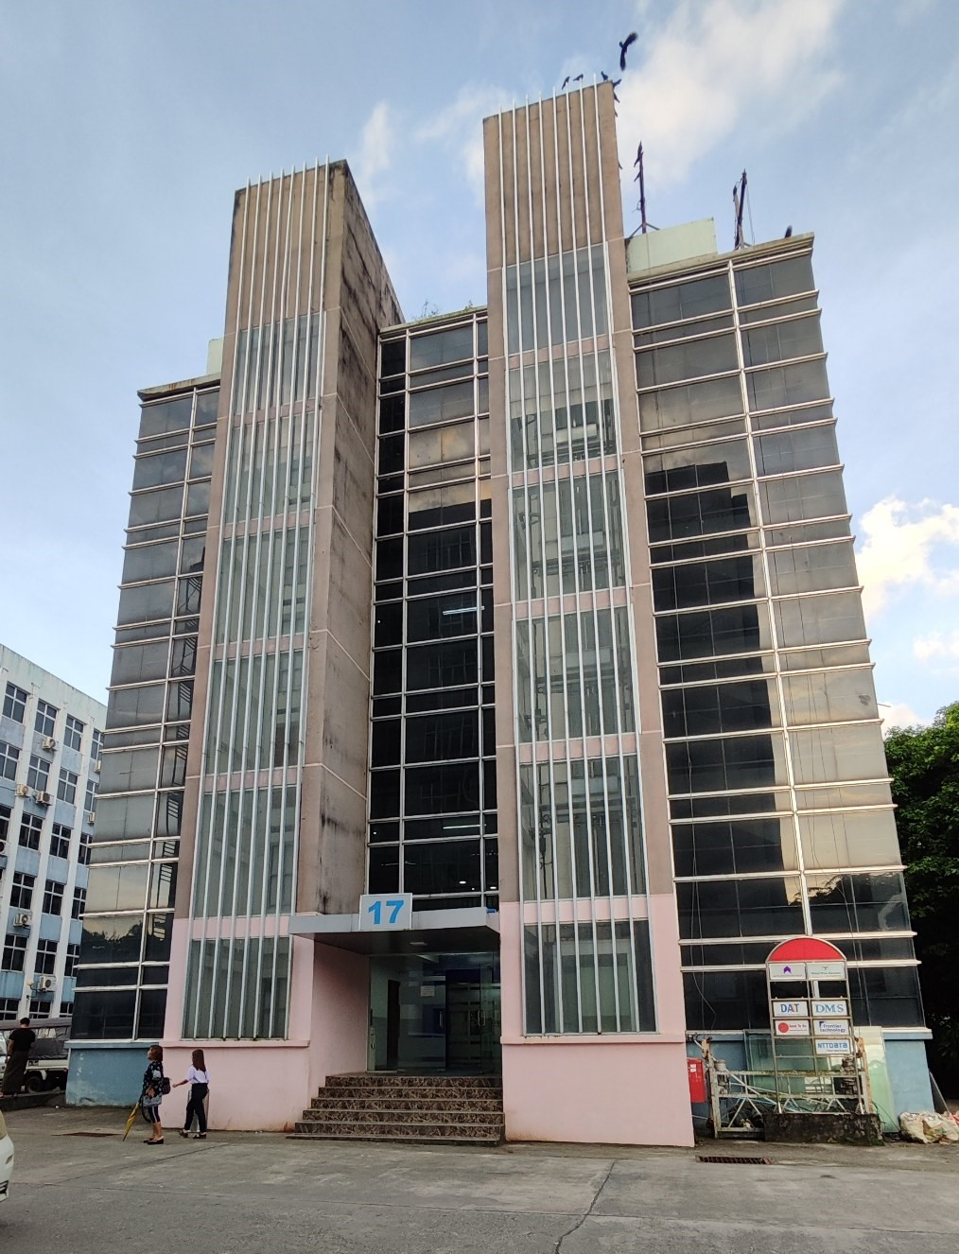
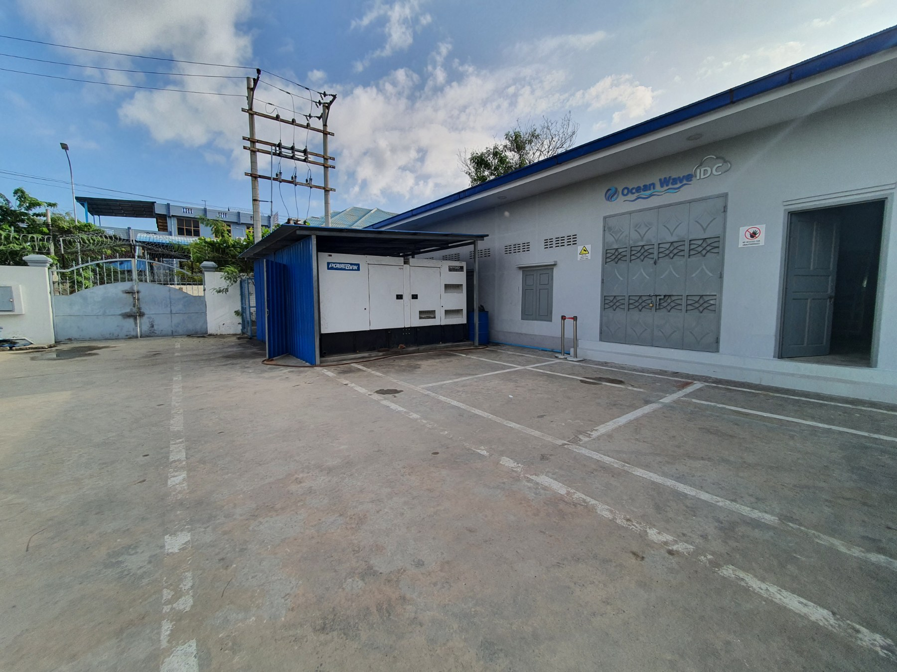
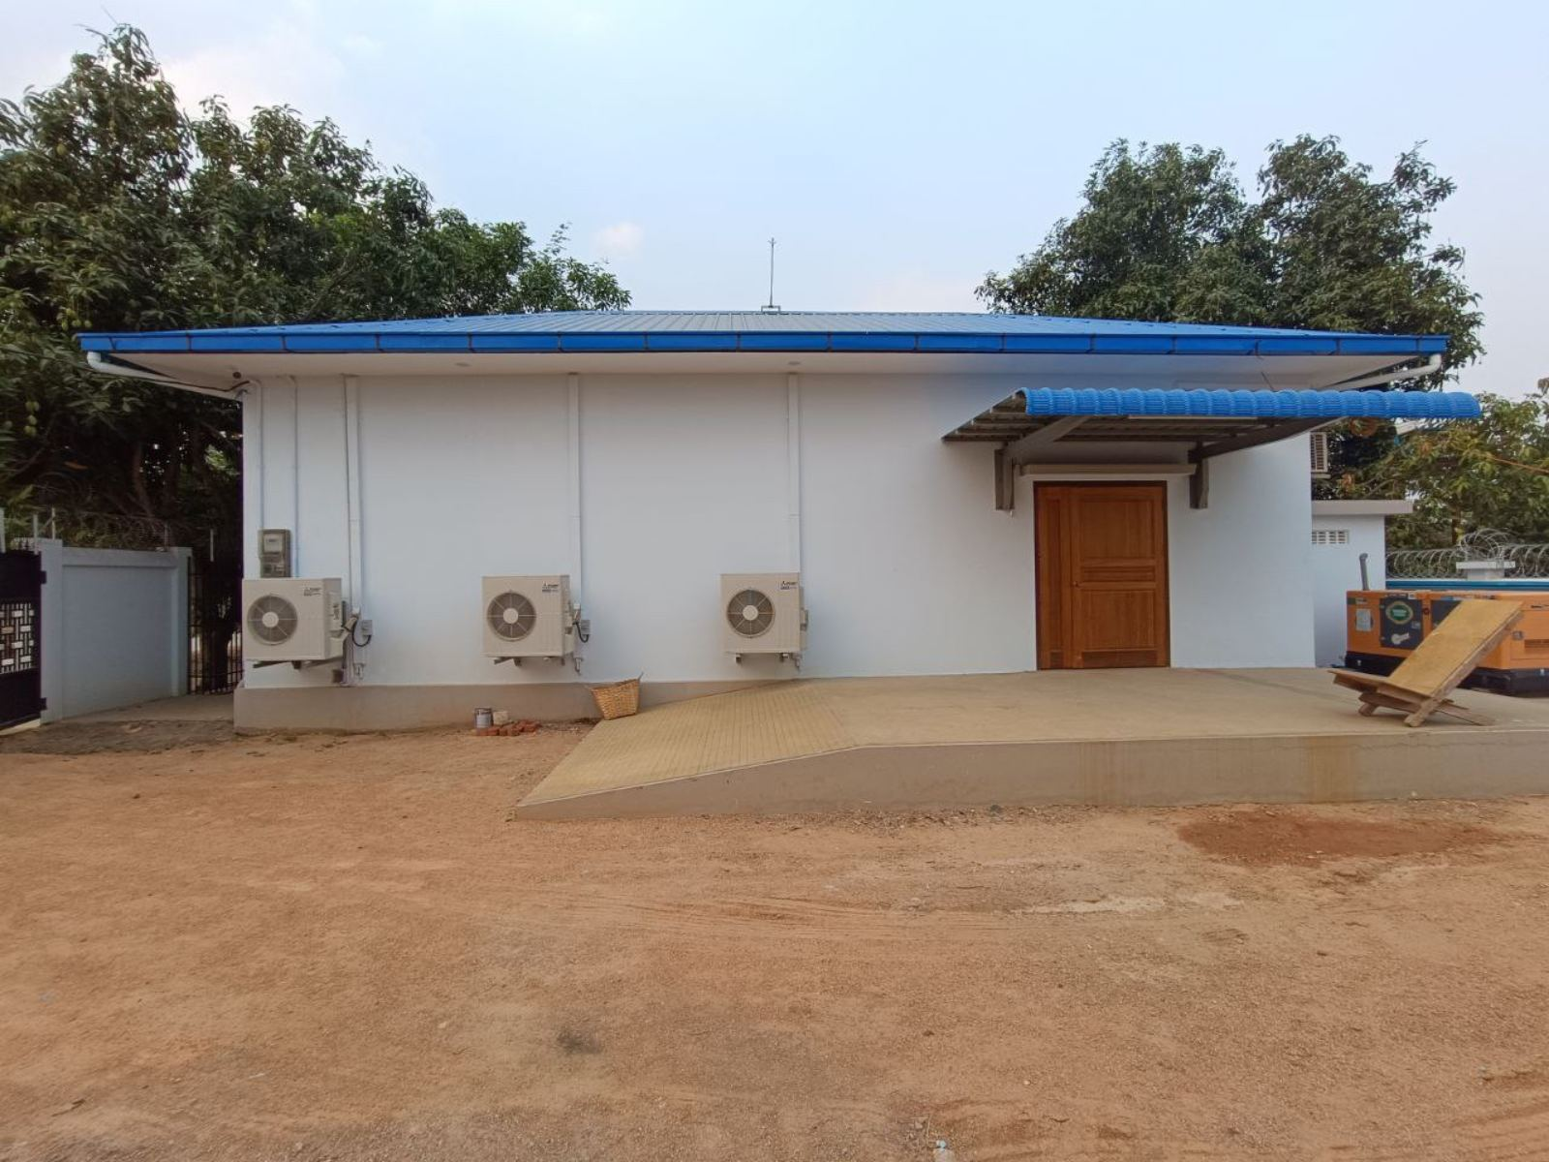
OceanWave IDC, Mandalay
IT Spectrum IDC, Naypyidaw
True IDC, MICT Park, Yangon

Slide 15
Current
Currently
2 x IXP
Service available in Yangon, Mandalay, Naypyitaw
Aggregated traffic - 140 Gbps
Total Connecting ASNs – 31
Major Content - Akamai, Google GGC, Wangsu, Netflix, Mobile Legend
DNS – K-root, PCH (ccTLD), MMIX owned DNS

Slide 16
Major Contents
CDNs
Google GGC – 17.5 G peak, Capacity Limited ( waiting for new node)
WangSu CDN – 12.55 G peak
Akamai – 130.48 G peak (YGN -74.64 G & MDY- 55.84 G )
Netflix – 1.46 G peak
DNS Servers
K-Root
PCH ( Country level root and various )
MMIX DNS
Well-known Peering Contents
Mobile Legend (MLG)
Kaopu Cloud – not in service yet..

Slide 17
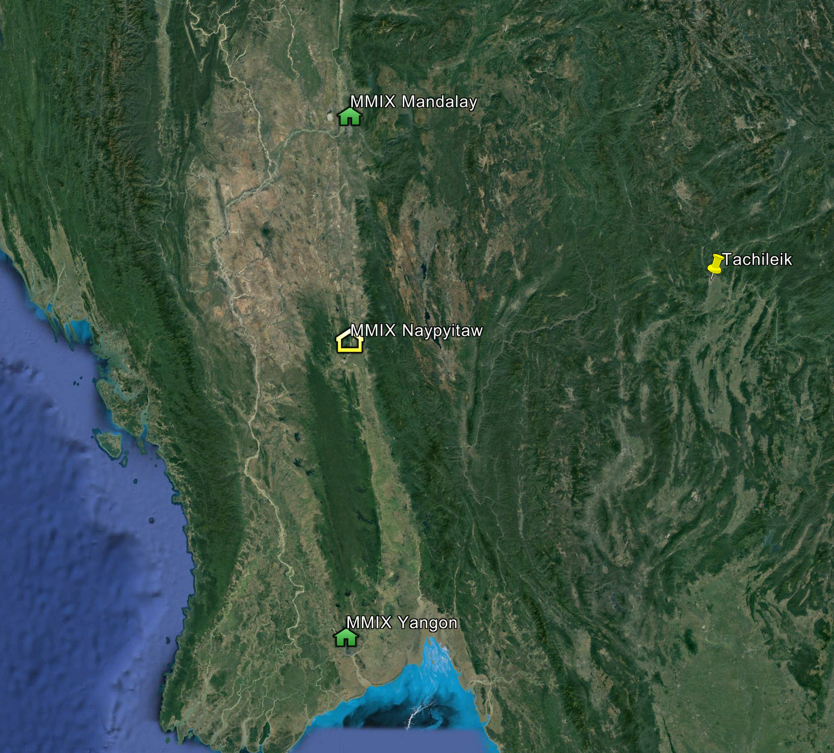
MMIX POPs
Yangon IXP
  in Sept 2017
Mandalay IXP
  in June 2023
Naypyitaw
  in June 2023
Tachileik
  In March 2024

Slide 18
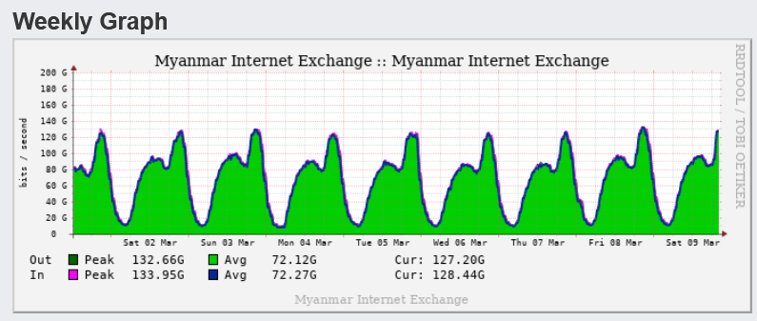
Current Traffic – Updated on 9 March 2024

Slide 19
Peer Ports
Port | Peering YGN | Peering MDY | Both
1G | 2 | 1 | 3
10G | 14 | 4 | 18
20G | 6 |  | 6
40G | 2 |  | 2
100G | 2 | 2 | 4
Total Peering |  |  | 33
CDN behind MMIX (GGC,NTFL) |  |  | 2

Slide 20





Network Connectivity's
RS
AS-9654, AS-9333
RS
AS-9333
CSP
CSP
ISP
YGN1
ISP
MDY-1
ISP
YGN-2
ISP
NPT-1
Legend:
RS – Route Server
Mandalay Peering
Yangon Peering
CSP
RS
AS-9654
ISP

Slide 21
Growth

Slide 22
MMIX’s Members Growth

Slide 23
MMIX’s Traffic Improvement
~ 100G International BW saving

Slide 24
Future

Slide 25

Future Network Topology
Countries
Cities
Cities
Countries
RS
RS
YGN-3
YGN1
MDY-1
MDY-3
RS
RS
YGN-4
YGN-2
MDY-2
MDY-4
Countries
Cities
Cities
Countries

Slide 26
Contents
CDNs
Google GGC Node for Mandalay IXP – Waiting for Equipment delivery
Netflix OCA Node for Mandalay IXP – Waiting for import license
Akamai CDN upgrade – Equipment arrived
Wangsu CDN upgrade – Waiting for Equipment delivery
Tencent CDN – Waiting for Equipment delivery
DNS Servers
M-Root Server – waiting for Equipment Delivery
Hosting
Free Hosting for Education - planning

Slide 27
IPv6 Deployment Plan
MMIX & Apnic
will setup
IPv6 deployment.
Pilot project for
selected ISP(s).
Training to the Engineers
Network Analysis for V6 readiness
Advise Network modification for V6 setup
Deployment support

Slide 28
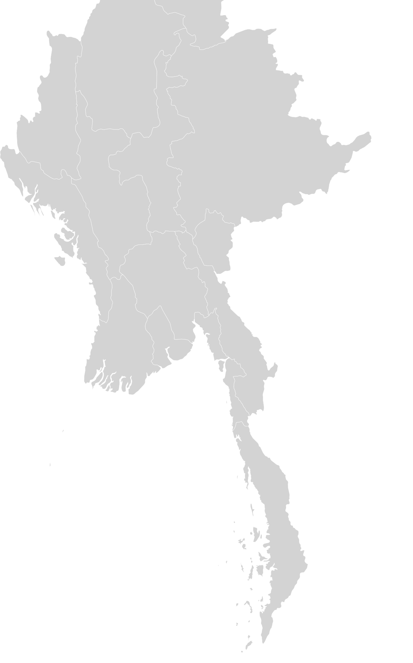


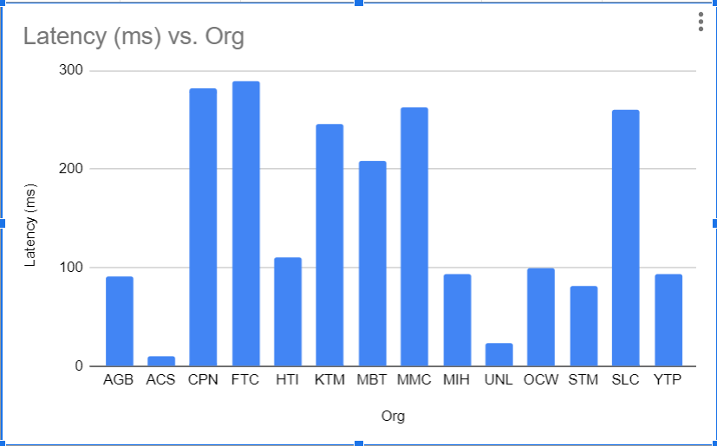


.mm & Government Servers reachability from MMIX
Latency result from the networks of the MMIX members to the Gateway IP 103.89.48.1 of ITCSD. <Mar-2023 data>
IX
L
M
?
ITCS
.mm
K
L
PCH
IX
Latency >10ms, < 289ms. Average is 153.5 ms
Apparently, latency high as no peering. Only peering can solve the problem.

Slide 29
Benefit after Gov. Networks connect to MMIX
Benefit | Conditions
Low Latency | Accessible smoothly from the networks of the members of MMIX
Internet Lost, still ok. | Still active locally when International links are cut off.
Internet Congest, still ok. | Accessible smoothly in local when International links are contested.
DDOS Attack, still ok | Accessible smoothly in local when there is DDOS attack from oversea.
Flexible security control | As direct connection with each ISPs, can control routing and security directly.
Internet
ITCS
MMIX
.mm
ISPs

Slide 30
Local CDN and Local Cloud
Local CDN
Setup distributed CDN for local content with affordable cost for content providers.
Partnership with technical group or persons or organization for setup, manage and operate CDN Infrastructure.
Invite content providers for hosting at MMIX CDN.
Local Cloud
Setup non-commercial cloud for education society.
Partnership with technical group or persons or organization for setup, manage and operate the cloud.
Invite Universities and Institution for free access to MMIX Cloud.

Slide 31
Others

Slide 32
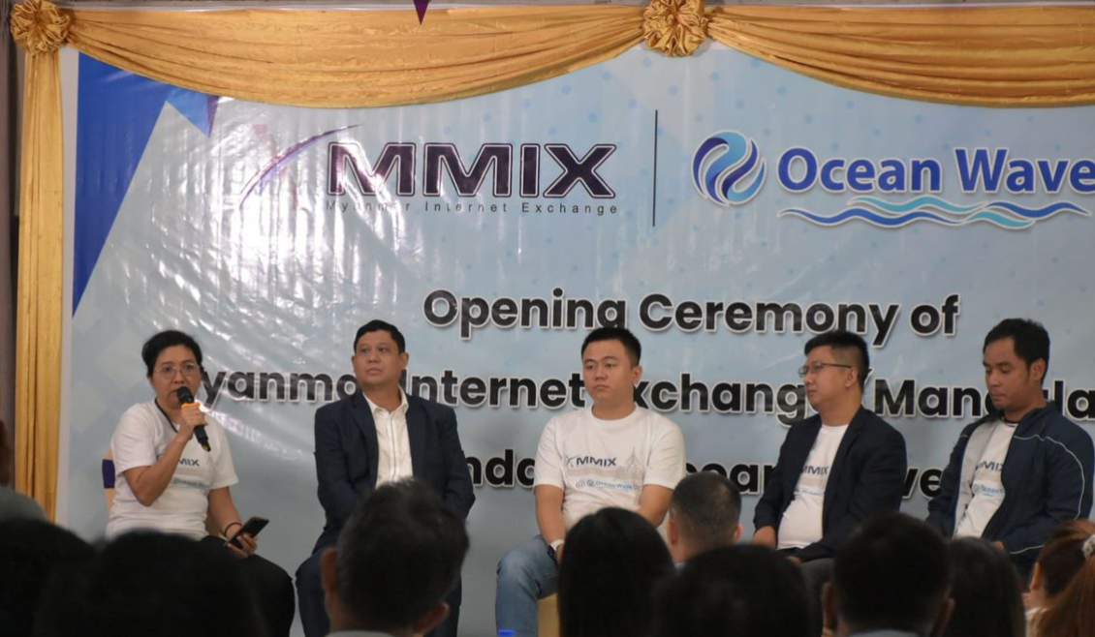
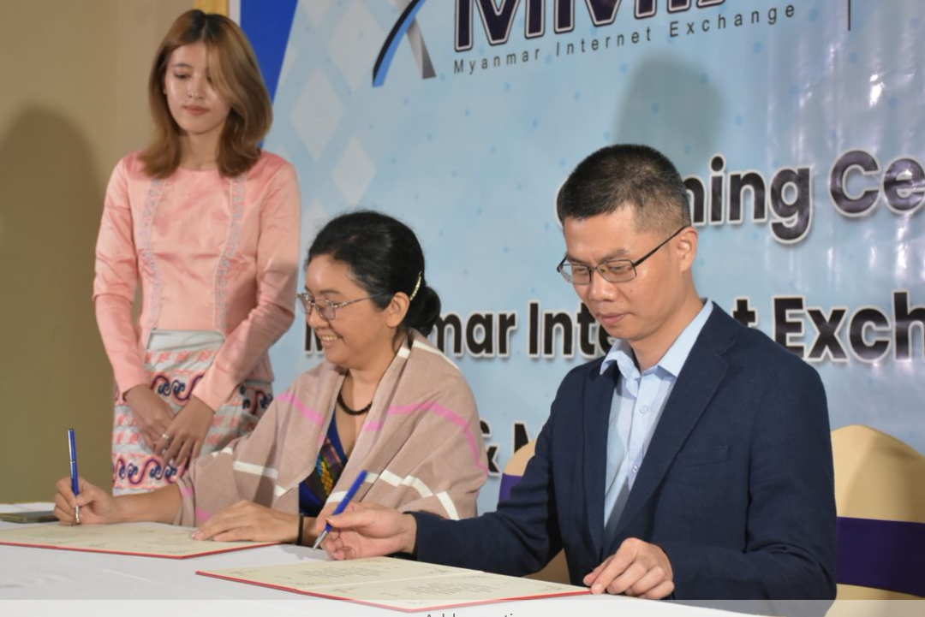
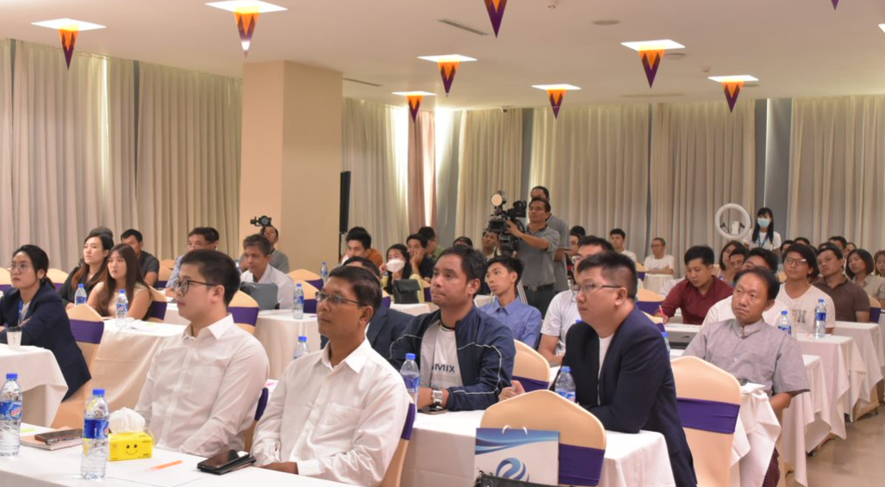
Mandalay IXP launched at June 2023

Slide 33


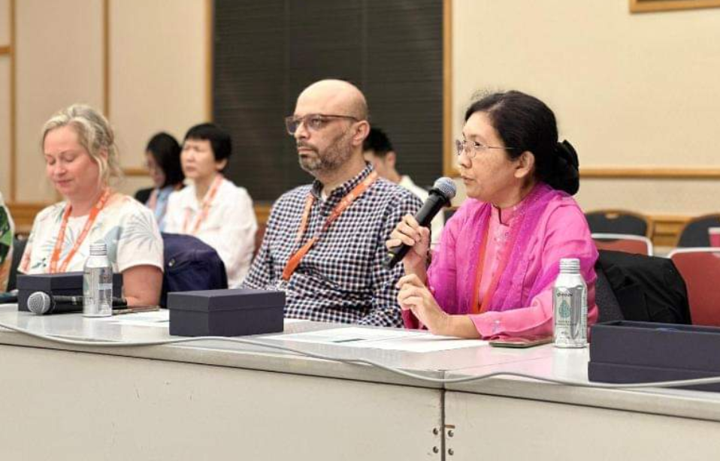
“CEO of Myanmar Internet Exchange (MMIX) Honored at IGF-2023 for Improving Internet Exchange Points in the Asia Pacific."

Slide 34
We shared the story of MMIX’s progress, specifically the technical details of MMIX’s second POP and how that benefited capacity, growth in traffic, and user experience, along with any difficulties, small or large, and how we were overcome. https://blog.apnic.net/2024/01/24/setting-up-mmixs-second-ixp/
Setting up MMIX’s second IXP (APNIC blog)

Slide 35

Thank you
Thein Myint Khine
MMIX
https://mmix.net.mm
info@mm-ix.net

