Slide 1
Setting up Simple Anycast DNS Recursive
Resolver for an ISP
Kaung Khant Kyaw
Myanmar Internet Exchange

Slide 2

What is DNS?
Resolve a fully qualified domain name (FQDN) to an IP Address IPs.
Hierarchical and decentralized naming system.
Example FQDN : www.google.com.
Hostname
Domain Name
TLD
Root Servers

Slide 3
Example of “DNS Hierarchy Structure”
. (Root)
Root Server
.com
.org
.net
Top Level Domain
mm-ix.net
mmnog.net
Second level Domain
Sub Domain
lg.mm-ix.net
register.mmnog.net

Slide 4



What is a Recursive DNS Server?
A recursive DNS server, also known as a recursive resolver or simply a resolver, is a fundamental component of the Domain Name System (DNS) infrastructure.
It’s is responsible for resolving the query. It starts by querying the root DNS servers, which point it to the appropriate Top-Level Domain (TLD) DNS server. The TLD server then directs the recursive server to the authoritative DNS server for the specific domain.

Slide 5
Recursive DNS Server's Mission:
Is to efficiently and reliably resolve domain names to their corresponding IP addresses.
It is emphasized that Name resolution, Caching, Query forwarding,...etc.
Describe it as the essential intermediary that makes internet navigation seamless for users.

Slide 6
Here’s the example picture how “Recursive DNS Server” works:
“.” Root Servers
https://www.mm-ix.net.
x.x.x.x
Top Level DNS servers
Recursive Server
Authoritative DNS Servers
https://www.mm-ix.net= x.x.x.x.

Slide 7
Type of Queries
Recursive Query
Is between DNS Client and its DNS Local Server.
Demands a name resolution or the answer “It can not be found”
Iterative Query
Is between local DNS Server and other DNS servers.
Other DNS servers may provide a name resolution or a referral.

Slide 8
Here’s the example picture how “Recursive DNS Server” works:
Iterative Query
Iterative Query
“.” Root Servers
Recursive Query
Iterative Query
Recursive Query
Iterative Query
Top Level DNS servers
Recursive Server
Iterative Query
Iterative Query
Authoritative DNS Servers

Slide 9





Advantages of
“ Local Recursive Resolver”
Efficient Name Resolution
Reduced Network Traffic
Improved User Experience
Load Balancing &
Redundancy
...etc.

Slide 10
Different between
“Authoritative DNS Server” and “Recursive DNS Server”
 | Authoritative DNS Server | Recursive DNS Server
Function | Provide official DNS records for a particular domain | Help resolve domain names to IPs by querying authoritative DNS servers.
Responsibility | Store and maintain DNS records for the domains | Don't store official records; they retrieve and cache info from authoritative servers.
Queries | respond to queries about specific domains with the accurate DNS records. | Issue queries to authoritative DNS servers to find the IP address associated with a domain.
Caching | don't typically cache records for other domains | Cache the results of queries to speed up future lookups.

Slide 11
What is Anycast?

Slide 12
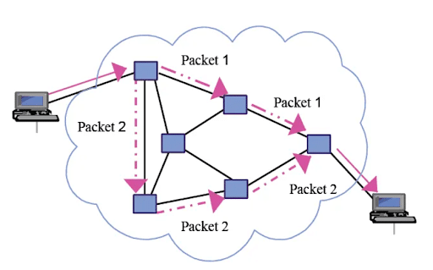
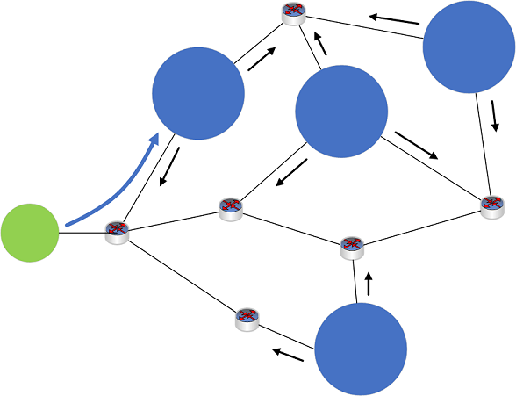

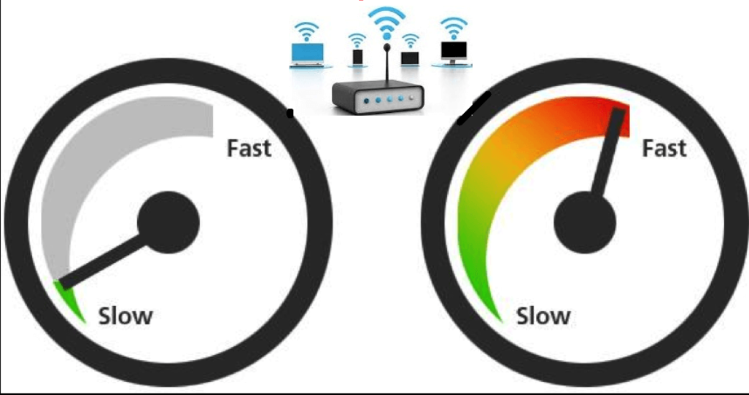
What is anycast? & Why Anycast?
Routing technique which routes packets to nearest destination.
Reduces latency by directing traffic to the closest server.
Provides redundancy and fault tolerance.
Enhances performance and reliability.
Often used for DDoS mitigation.

Slide 13
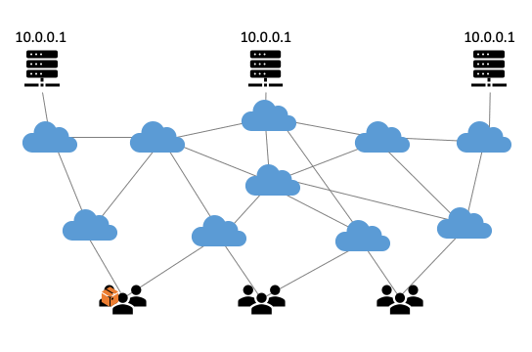
The example of Anycast network routing!!!
Reference from SIDN Labs

Slide 14
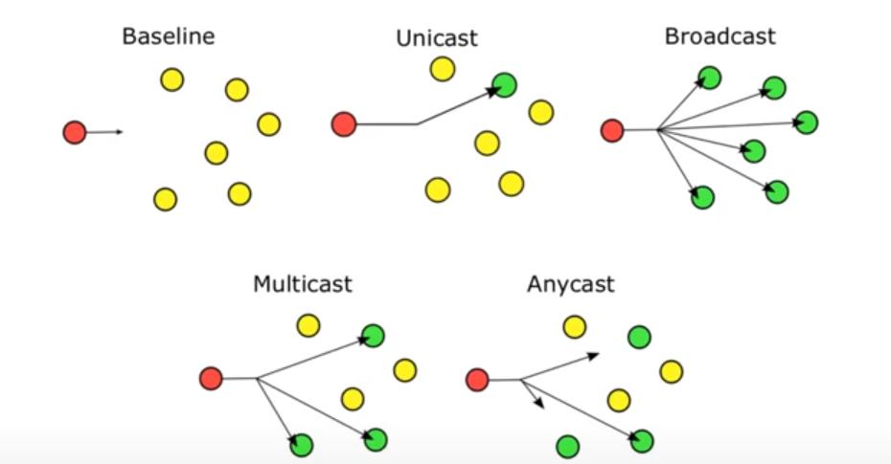
Routing Schemes Compared
Reference from ISOC Anycast DNS training

Slide 15

Advantages of running anycast on recursive DNS servers
Running anycast on recursive DNS servers provides several advantages that enhance the performance, availability, and reliability of DNS services. Anycast is a network addressing and routing technique that allows multiple servers located in different geographic locations to share the same IP address.
Load Distribution
Proximity-based Routing
High Availability
Scalability
Cost Efficiency
Simplified Configuration
……etc.

Slide 16
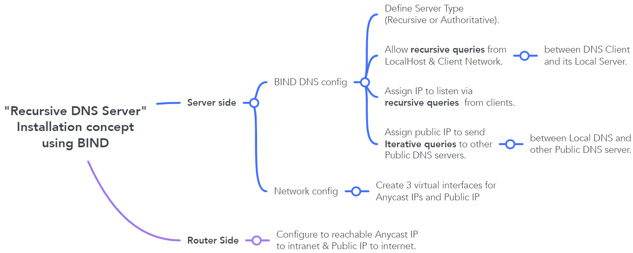
Recursive DNS Server Installation concept.

Slide 17


Recursive DNS Server Installation concept.
recursion
- To define Authoritative server or Recursive DNS Server.
allow-query
- To allow who can query the domain to this server.
listen-on
- To listen client DNS queries
query-source
- To send query to another DNS server.

Slide 18
Recursive DNS Server Installation Example.
Bind DNS Configuration
/etc/bind/named.conf.options
options {
directory "/var/cache/bind";
recursion yes; // allow recursive queries
allow-query { localhost; 172.16.255.0/24; }; // allow queries from localhost and client network
listen-on { localhost; 10.10.10.10; 11.11.11.11; }; // allow server IPV4 address to listen DNS queries from client
query-source 103.103.1.1; //Specific IP address for DNS Server Outbound Query
dnssec-validation auto;
listen-on-v6 { any; };
};
logging{
channel query logging {
file "/var/log/named/query.log" versions 3 size 10m;
severity debug 3;
print-time yes;
print-severity yes;
print-category yes; };
category queries {
query logging; };
};

Slide 19
Recursive DNS Server Installation Example.
Network Configuration
$ IP addr
ens3: <BROADCAST,MULTICAST,UP,LOWER_UP> mtu 1500 qdisc fqcodel state UP group default qlen 1000
link/ether 00:50:01:00:16:00 brd ff:ff:ff:ff:ff:ff
inet 172.16.1.2/24 brd 172.16.1.255 scope global ens3
valid_lft forever preferred_lft forever
inet6 fe80::250:1ff:fe00:1600/64 scope link
valid_lft forever preferred_lft forever
any10.vip: <BROADCAST,NOARP,UP,LOWER_UP> mtu 1500 qdisc noqueue state UNKNOWN group default qlen 1000
link/ether 0e:f0:e8:74:2e:69 brd ff:ff:ff:ff:ff:ff
inet 10.10.10.10/32 scope global any10.vip
valid_lft forever preferred_lft forever
inet6 fe80::cf0:e8ff:fe74:2e69/64 scope link
valid_lft forever preferred_lft forever
any11.vip: <BROADCAST,NOARP,UP,LOWER_UP> mtu 1500 qdisc noqueue state UNKNOWN group default qlen 1000
link/ether 3a:e7:76:ec:28:13 brd ff:ff:ff:ff:ff:ff
inet 11.11.11.11/32 scope global any11.vip
valid_lft forever preferred_lft forever
inet6 fe80::38e7:76ff:feec:2813/64 scope link
valid_lft forever preferred_lft forever
public.vip: <BROADCAST,NOARP,UP,LOWER_UP> mtu 1500 qdisc noqueue state UNKNOWN group default qlen 1000
link/ether 22:94:a7:80:e7:e2 brd ff:ff:ff:ff:ff:ff
inet 103.103.1.1/32 scope global public.vip
valid_lft forever preferred_lft forever
inet6 fe80::2094:a7ff:fe80:e7e2/64 scope link
valid_lft forever preferred_lft forever

Slide 20
Failover Concept

Slide 21
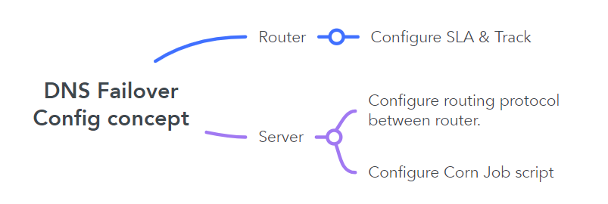
Failover Configuration basic concept.

Slide 22
Configuration Example. (Router-side)
#SLA Configuration
Router(config)# ip sla (operation number)
Router(config-ip-sla)#dns [hostname] name-server [DNS server address]
Router(config-ip-sla-dns)# frequency [ - ]
Router(config-ip-sla-dns)# threshold [ - ]
Router(config-ip-sla-dns)# timeout [ - ]
#Track Configuration
Router# track [obj-No.] ip sla [entry No.] reachability
Router# delay up 1 down 1
#Configuring floating Static route with Track object
Router# ip route [DNS-server IP] [Netmask] [Next-Hop] track [obj-No.] [Metric]

Slide 23
Configuration Example. (Server-Side)
# Adding Cron Job Script
#!/bin/bash
while true; do
/usr/bin/dig @10.10.10.10 localhost. A +short
if [[ $? != 0 ]]; then
echo "DNS service down"
/etc/init.d/frr stop
else
echo "DNS service up"
/etc/init.d/frr enable
/etc/init.d/frr start
fi
done

Slide 24
Thank you

