Slide 1
A plenarily integrated SIEM solution
And
it’s Deployment.
Md. Rashedul Hasan E-mail: rashedul.engr@gmail.com
Dhaka, Bangladesh

Slide 2
SIEM & it’s Capabilities
SIEM Capabilities
SIEM solution is an essential piece of a security operations center (SOC) toolkit.
SIEM solutions collect data from across an organization's security architecture and alert about attacks, enabling rapid detection and response to threats.
Security Log Analysis
Vulnerability Detection
Vulnerability Detection
Security Configuration Assessment
Regulatory Compliance

Slide 3
Why Wazuh SIEM?
Wazuh is a free and open source security platform that unifies XDR and SIEM capabilities. It protects workloads across on-premises, virtualized, containerized, and cloud-based environments. Wazuh helps organizations and individuals to protect their data assets against security threats.
Some of the more common use cases of the Wazuh solution-
Intrusion detection
Log data analysis
File integrity monitoring
Anomaly and Malware detection
Vulnerability detection
VirusTotal integration
Configuration assessment
Incident response
Regulatory compliance (NIST, PCIDSS, GDPR, NIST, TSC and HIPAA)
IT Hygiene
Cloud security
Containers security
Posture Management
Workload Protection

Slide 4
Integrations
Microsoft 365 and Microsoft 365 Defender
Malware Detection with Virultotal with Active Response
Malware Detection with Yara with Active Response
SSH brute-force detection with Active Response
Monitoring malicious command using aduitd
Suricata integration for IDS
Building IOCs file threat intelligence
LimeRAT detection with active response
Thehive integration for incident response
Cortex Integration with Thehive for observable analysis

Slide 5
WAZUH SIEM Deployment
Wazuh can be deployed in two ways:
All In One: Wazuh Server and ELK Stack are installed and configured on the same system.
Distributed: Each component is setup on a seperate Server.
SIEM Cluster Deployment
Standalone SIEM Deployment
S1
S1
SIEM
Load Balancer
S2
S2
SIEM
SIEM
S3
S3
Event Flow
Event Flow

Slide 6
Preparing for the Installation
Operating System:
Wazuh can be installed on various operating systems, including CentOS, Debian, Ubuntu, Windows, and macOS.
Hardware Specifications:
Hardware requirements highly depend on the number of protected endpoints and cloud workloads.
Software Dependencies:
Wazuh requires several software components, including Elastic Stack, Filebeat, and Wazuh Manager.
Elastic Stack is a set of open-source tools for data processing and analysis, including Elasticsearch, Logstash, and Kibana.
Filebeat is a lightweight agent that collects log data from different sources and forward it to Elasticsearch.
Wazuh Manager is the central component of the Wazuh architecture, which receives data from the Wazuh Agents and processes it to generate alerts and notifications.

Slide 7
Step-by-Step Installation
Step 1: Set Up Wazuh Server
Install Wazuh
Install Wazuh Manager
Install Elasticsearch
Install Filebeat
Install Kibana
WAZUH
SEIM
Linux Server

Slide 8
Step-by-Step Installation (Cont.)
Windows Host
Step 2: Install and Configure Wazuh Agents
Configure Windows Agent into Windows Host
Configure Windows Agent into Linux Host
Switch
Linux
Host

Slide 9
Step-by-Step Installation (Cont.)
Syslog Server
Step 3: Install and Configure Syslog Server
Configure Linux Server as a Syslog Server
Configure Wazuh Agent into this Syslog Server
Linux Server

Slide 10
Step-by-Step Installation (Cont.)
Step 4: Configure Network Devices to Send the Log to the Syslog Server
Set the Destination Address to Send the Log from the Devices to Syslog Server.
Check the Incoming Logs From the Syslog Server.
Configure Wazuh Server to Receive the Log From the Wazuh Server.
Check the Incoming Logs for Syslog Server
Step 5: Configure Security Event Collection
Step 6: Enable Real-time Monitoring and Alerting
Step 7: Perform Regular Log Analysis and Incident Investigation
Step 8: Continuously Enhance Security Posture
Router
Syslog Server
Firewall

Slide 11
Complete Diagram with Wazuh SIEM
Windows Host
Router
WAZUH
SEIM
Syslog Server
Switch
Switch
Firewall
Linux
Host

Slide 12
Data Flow between Wazuh and connected devices.
Windows Host
Router
WAZUH
SEIM
Syslog Server
Firewall
Linux
Host
12

Slide 13
Wazuh SIEM Demo

Slide 14
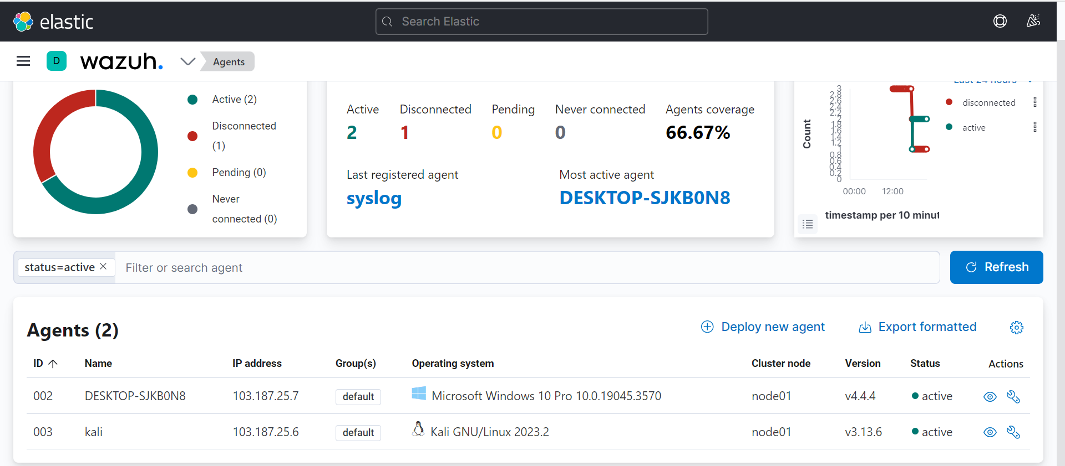
Agents overview
All configured Host (Agent) is showing into the Agents List with Active, Disconnected, Pending Never Connected List.

Slide 15
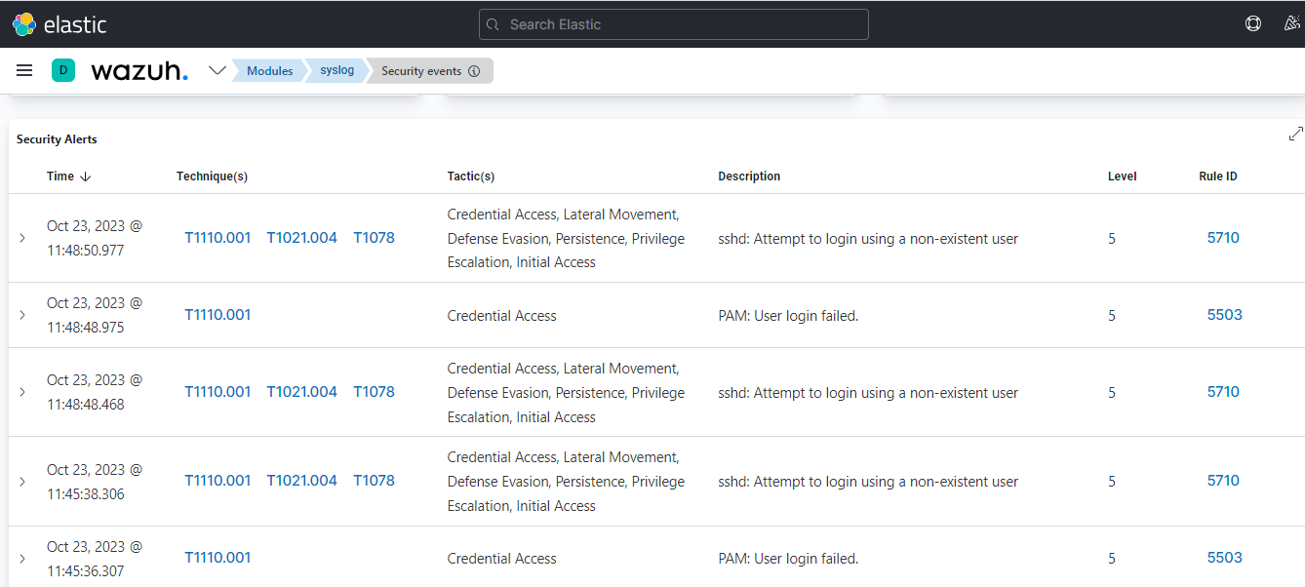
Security Events Monitoring (Failed Login Attempts)

Slide 16
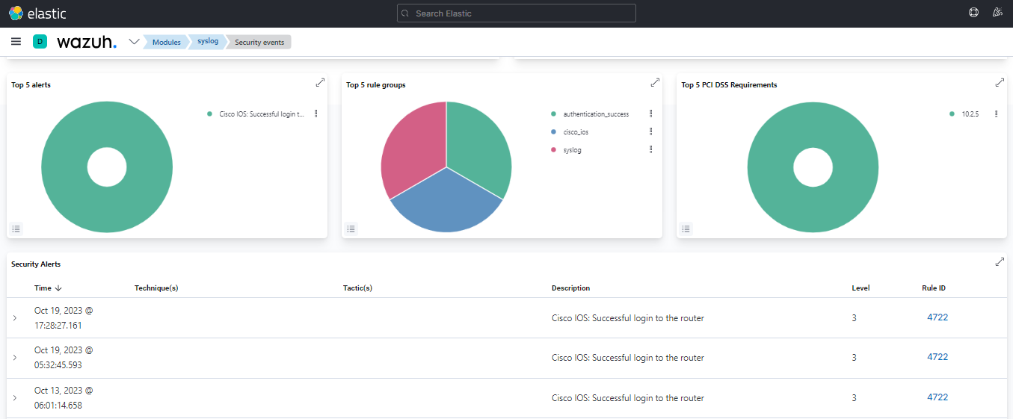
Security Events Monitoring (Successful Login Attempts)

Slide 17
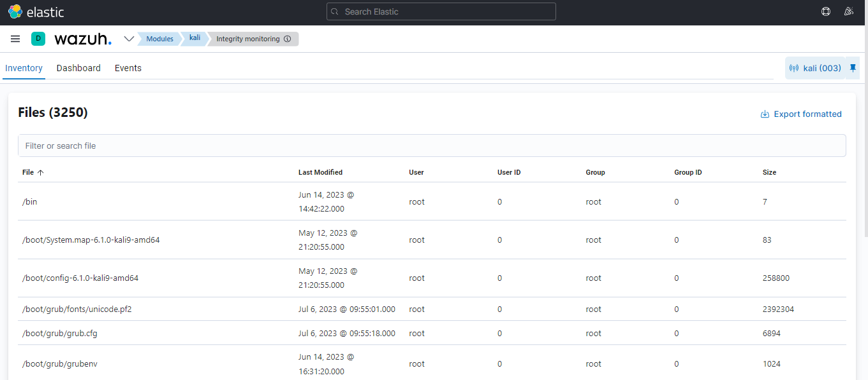
File Integrity Monitoring Dashboard
Identifying changes in context, permissions, ownership & attribute
Graph view of modified, added and deleted files over time
Use case of detecting threat
Use case of regulatory compliance like ISO 27001, NIST 800-53

Slide 18
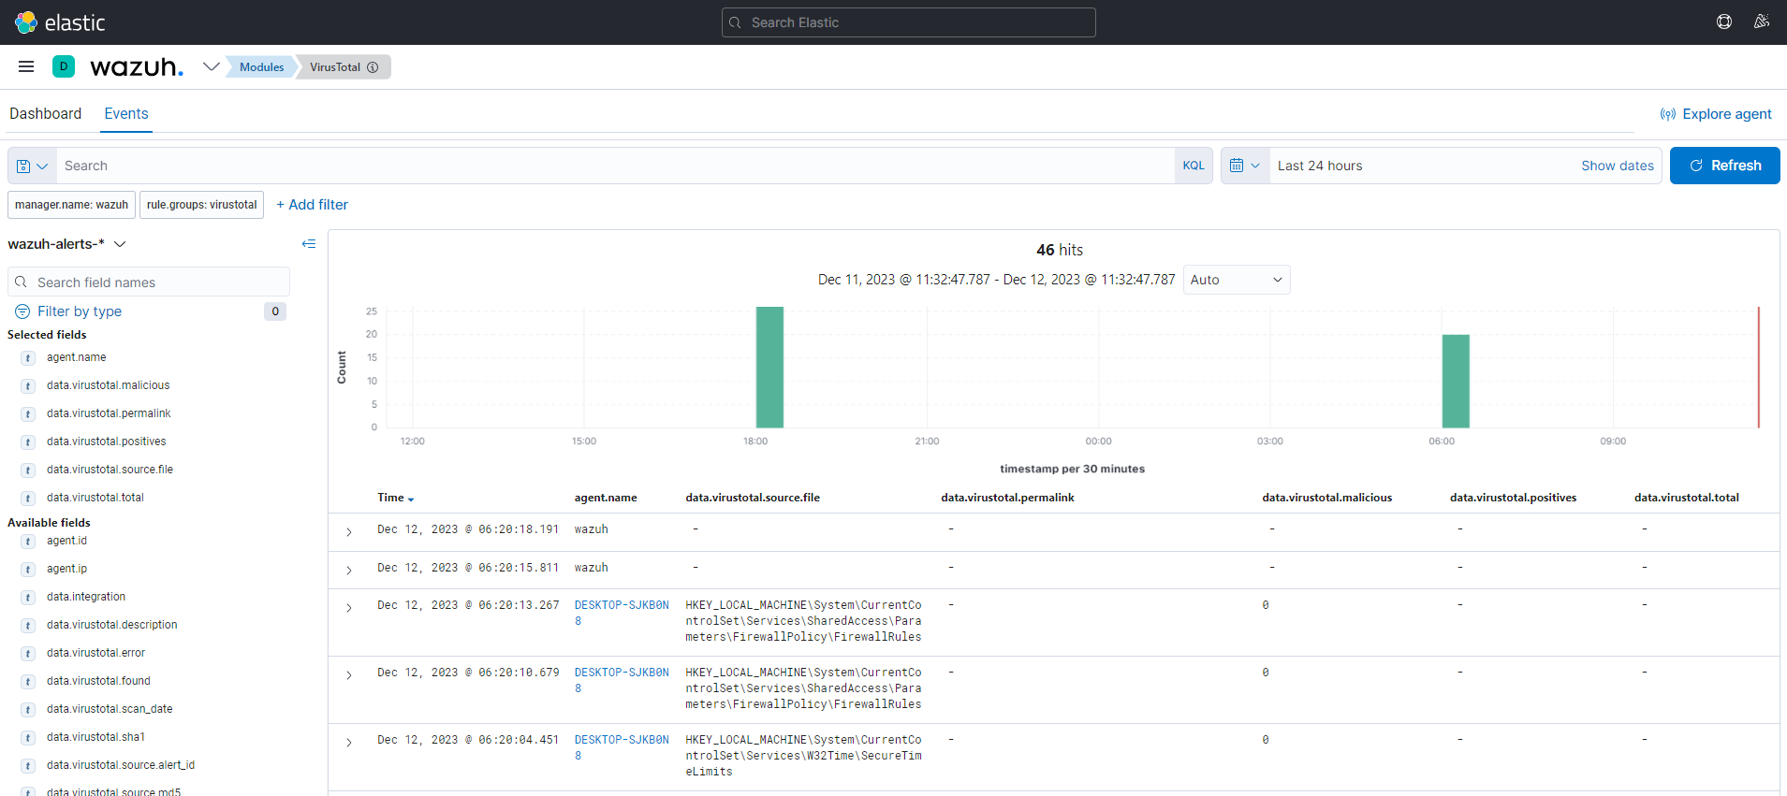
VirusTotal Integration
Real Time Virus and malware detection
Effective way of inspecting monitored files for malicious content
Manager & Endpoint both needs manual integration remediation

Slide 19
VULNERABILITY DETECTION:
Discover vulnerabilities of OS and applications installed on the monitored endpoints and matches to CVE & CVSS
Automatic vulnerability detection and assessment
External vulnerability feeds indexed by National Vulnerability Database (NVD), Canonical, Debian, Red Hat, Arch Linux Advisories Security (ALAS), Microsoft.
Office 365 Integration:
Event Severity Graph
Phishing and Malware Information
User Activity Information
MITRE ARR&CK
Review MITRE ATT&CK techniques in environment mapped to problem reports
MITRE tactics and their associated techniques
Alert evolution by Graph

Slide 20
Security Configuration Assesment:
Scan to detect misconfiguration and exposures, based on CIS controls
Recommends remediation action
Container Security:
Providing Comprehensive visibility into container resources
Capability to audit Kubernetes Infrastructure

